Slide 1



EVENTEASE-EVENT MANAGEMENT PLATFORM
CAPSTONE PROJECT
Presented by:-
KOTHA ASWITHA
KALLE AMRUTHA
LATHA TS
CHINTHAPANDU VENKATA SUPRAJA
VAIBHAV SHETTY
ADITYA VARDHAN SINGH

Slide 2


Table of Contents
01
Problem statement
02
Abstract
03
Objectives
04
Tech Stack
05
Usecase diagram
06
API Structure
07
Results/Expected Outcomes
08
Conclusion
02/12

Slide 3


Problem Statement
Event management is often disorganized for both organizers and participants.
Goal: Build a digital solution that enables users to:
Create events
RSVP easily
View attendees
Manage everything online
03/15

Slide 4

ABSTRACT
Event Ease is a full-stack web application developed using the MERN stack that simplifies event management for both organizers and participants. The platform allows organizers to create and manage events, while participants can browse upcoming events and RSVP seamlessly. With user authentication, role-based access control, and a responsive UI, Event Ease delivers a streamlined experience for event hosting and participation. The project emphasizes real-world collaboration, secure data handling, and modern web development practices.
04/15

Slide 5


OBJECTIVES
Key Features:
Create events and manage events(for organizers only)
Browse upcoming events, RSVP, and view details (for participants)
View RSVP lists for each event (for transparency and engagement)
Event filters based on date or location
05/15

Slide 6





TECH STACK FOR THE PROJECT
MongoDB for the database
Express.js for the API endpoints
React for the client-side user interface
Node.js as the runtime environment for the server
JWT for secure authentication
bcrypt.js for password hashing.
Postman for testing API endpoints.
Git & GitHub for version control and collaboration.
06/15

Slide 7

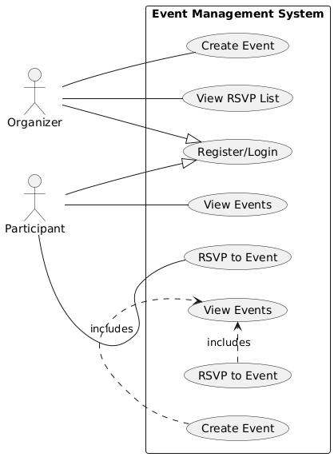
Usecase Diagram
07/15

Slide 8
API STRUCTURE
POST /api/auth/register :-This endpoint allows a new user to register by providing their name, email, password, and role (either "organizer" or "participant").
POST /api/auth/login :-Authenticates a user and returns a JWT token upon successful login. This token is used to access protected routes.
GET /api/events :-Retrieves a list of all upcoming events. This endpoint is accessible to all users, both organizers and participants.
POST /api/events :-Allows authenticated users with the "organizer" role to create a new event. Requires JWT token in the headers.
GET /api/events/:id :-Fetches detailed information about a specific event based on its ID.
POST /api/events/:id/rsvp :-Lets a participant RSVP to a specific event by submitting their name and email.
GET /api/events/:id/rsvps :-Retrieves a list of users who have RSVP'd for a specific event. This may be restricted to the organizer.
08/15

Slide 9
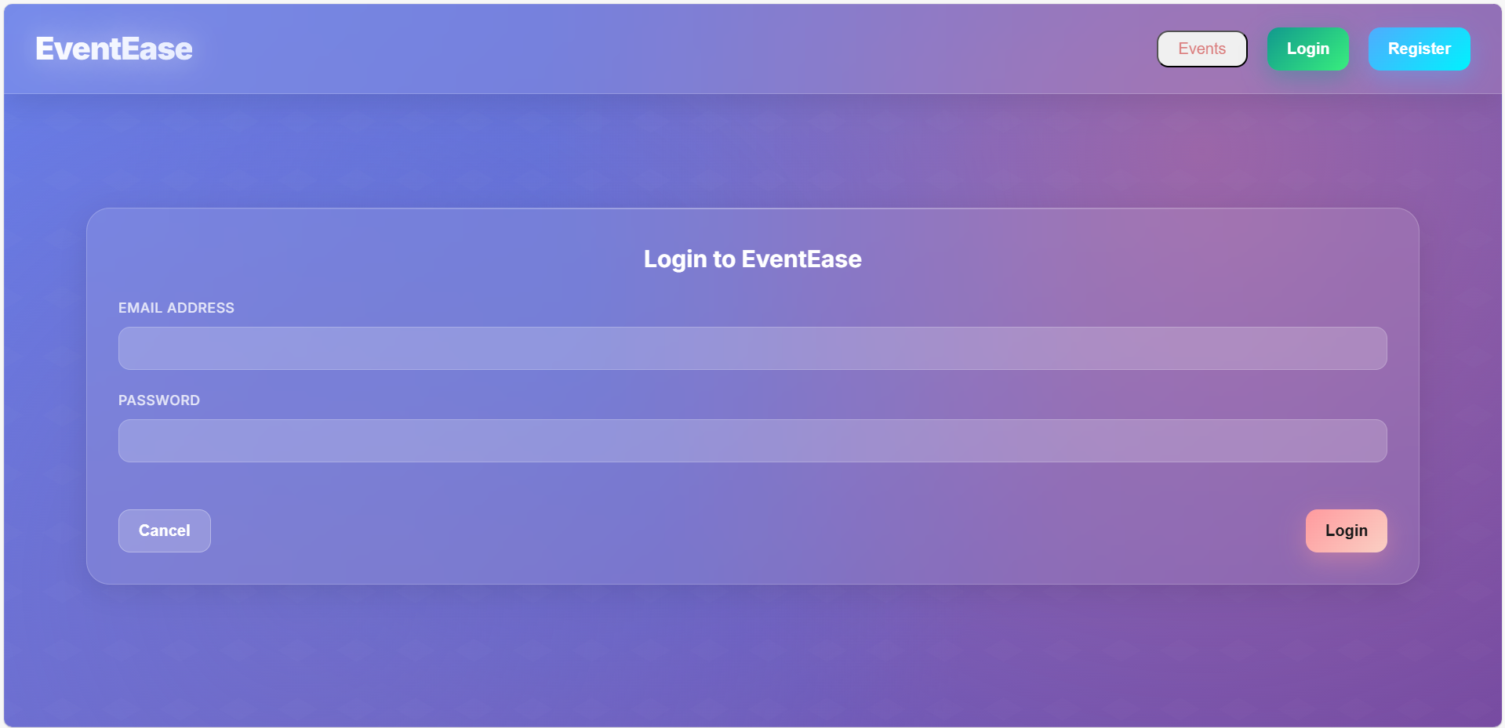
Results/Expected Outcomes
Login Page
09/15

Slide 10
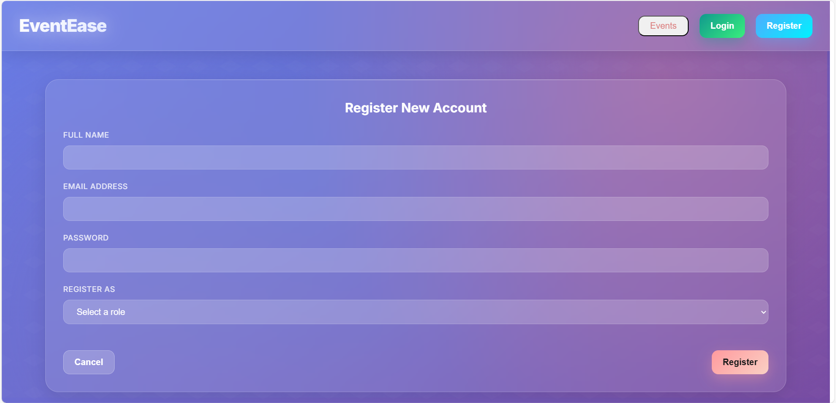
Results/Expected Outcomes
Registration Form
10/15

Slide 11
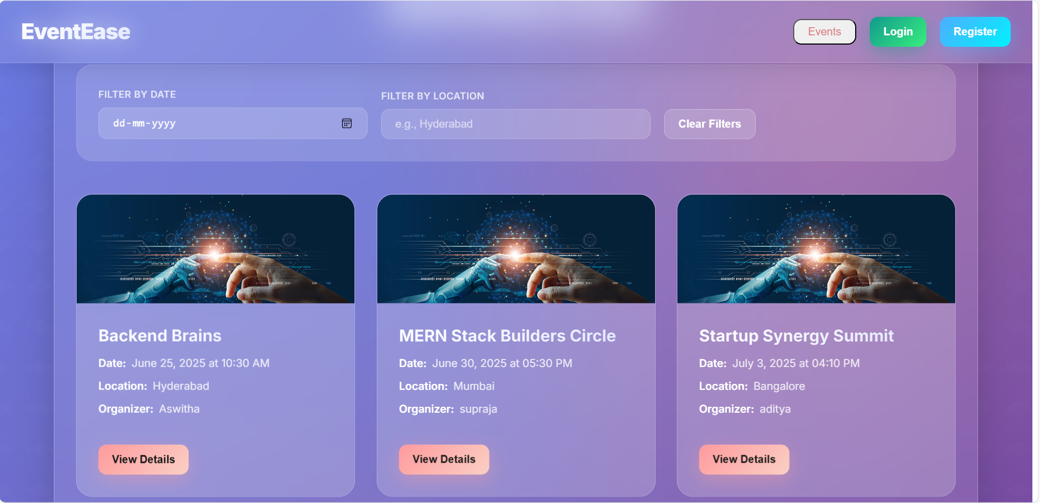
Results/Expected Outcomes
Home Page
11/15

Slide 12
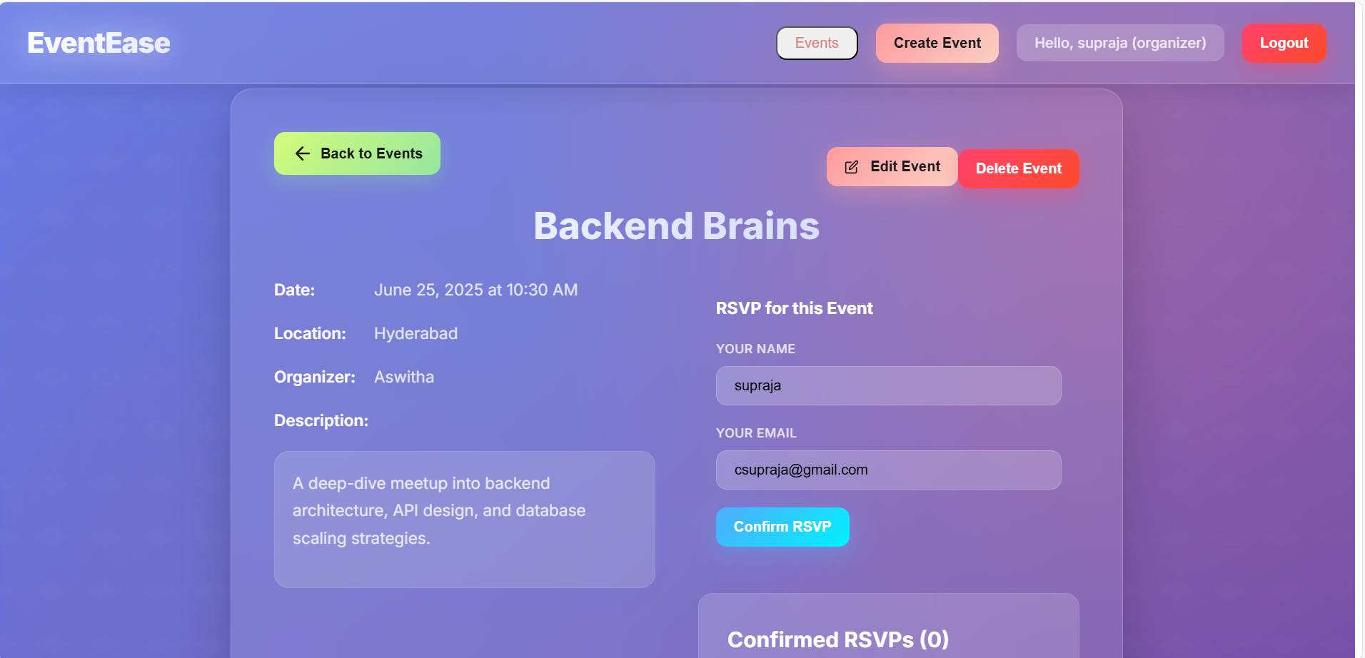
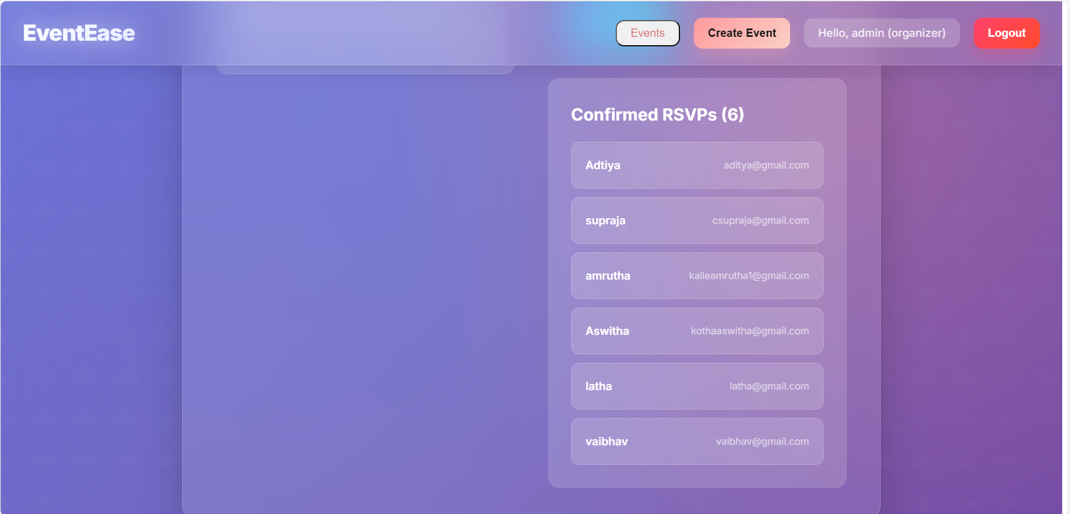
Results/Expected Outcomes
RSVP/Event Details/Attendee List
12/15

Slide 13
Conclusion
EventEase simplifies the event management process for organizers and participants by:
Digitizing event planning
Making RSVP seamless
Providing responsive, secure, and modern UI
Outcome: Hands-on MERN project that taught us full-stack development, API design, database modeling, and team collaboration.
13/15

Slide 14
THANK YOU

